Slide 1
sunhaotai
Jilin University

Slide 2
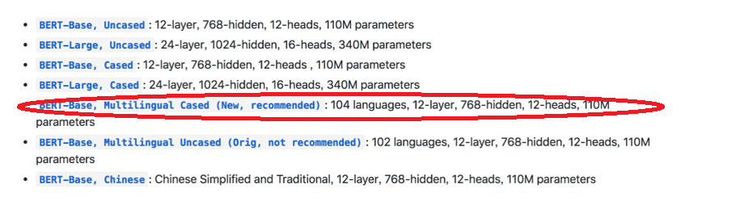
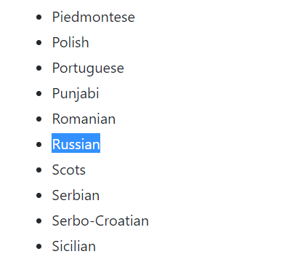
Bert
Bert：There are two multilingual models currently available，Russian is already supported

Slide 3
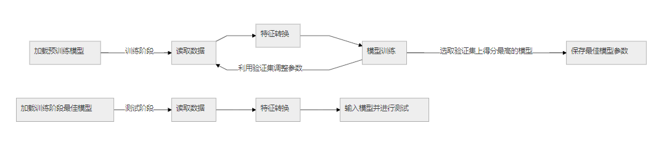
Bert
Bert：工作流程

Slide 4
Bert
Training Parameters：
--data_dir=$MY_DATASET \
--vocab_file=$BERT_BASE_DIR/vocab.txt \
--bert_config_file=$BERT_BASE_DIR/bert_config.json \
--output_dir=/tmp/sim_model/ \
--do_train=true \
--do_eval=true \
--init_checkpoint=$BERT_BASE_DIR/bert_model.ckpt \
--max_seq_length=72 \
--train_batch_size=32 \
--learning_rate=0.01\
--num_train_epochs=70
MRR test
Train quantity：4546
Test quantity：800
名称 | LSTM+CNN | LUCENE | Bert
MRR | 0.313 | 0.346 | 0.415

Slide 5
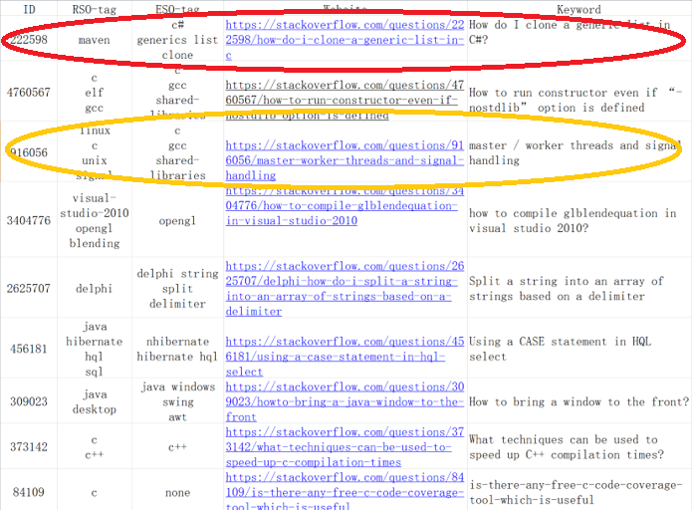
The Tag processing
（1）In the text similarity matching process of this project, any tag in the rso-tag and eso-tag is the same, and the text similarity is calculated.
（2）If the tag in eso-tag has no match in eso-tag, the text similarity of all data sets is calculated.
Notes:
（1）在本项目文本相似度匹配过程中，RSO-tag与ESO-tag中有任意一个标签相同，进行文本相似度计算。
（2）如果ESO-tag中标签在ESO-tag中无匹配项，则对全部数据集进行文本相似度计算。

Slide 6
The Tag processing
MRR test
Train quantity：4546
Test quantity：800
MRR=0.476
MRR result analysis
The observation results are summarized as follows:
Tag complete matching or partial matching accounted for 83%
RSO-Tag《------------------》ESO-Tag | Quantity | Proportion
Match | 218 | 4.07%
Partial matching | 4237 | 79.26%
Mismatch | 891 | 16.67%

Slide 7
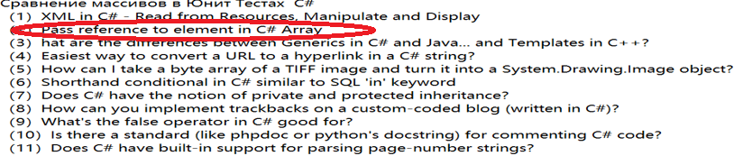
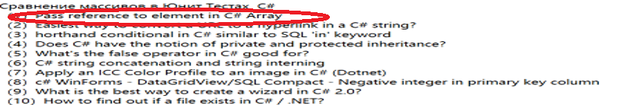
The Tag processing
（1）Filtering through tag can remove a lot of interference items. There are some texts with different tag, but the similarity of this paper is very high, causing a lot of interference
（2）Filtering through tag can remove many interference items that rank high.
Before Tag matches ：
Tag matched ：

Slide 8
The Tag processing
Next week: cross-language BERT: Facebook proposes cross-language pre-training model XLM

